Slide 1
Machine Learning Term Project
정두화, 이정명, 최찬영, 허서윤

Slide 2
100%
Classification
&
Clustering
Wise Prophet
&
Member rules
Introduce
01
02
03

Slide 3
01
Introduce

Slide 4
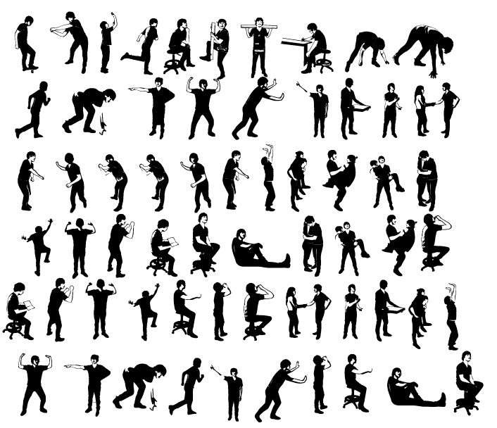
100%
Project Title
Watching motion and predicting what action to take

Slide 5

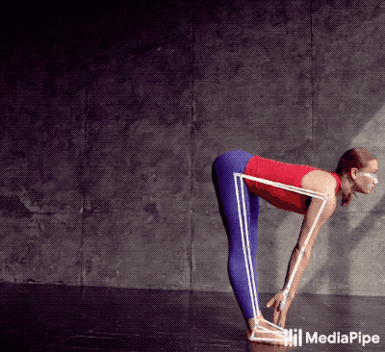
100%
Library
Motion Tracking Library
Dataset URL : https://google.github.io/mediapipe/solutions/pose.html

Slide 6
100%
Project Idea
We will create a program to
“find out what posture this person is currently taking”
by using a dataset with coordinates for each body part.
Motion Tracking
&
Extract pose (x,y)
YOGA
input
output
Preprocessing
Find Best Model
Fitting Model

Slide 7
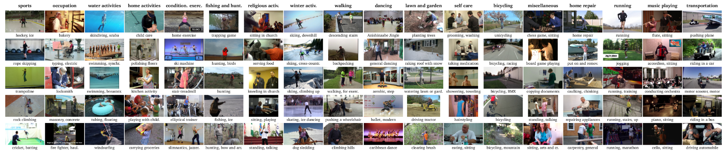
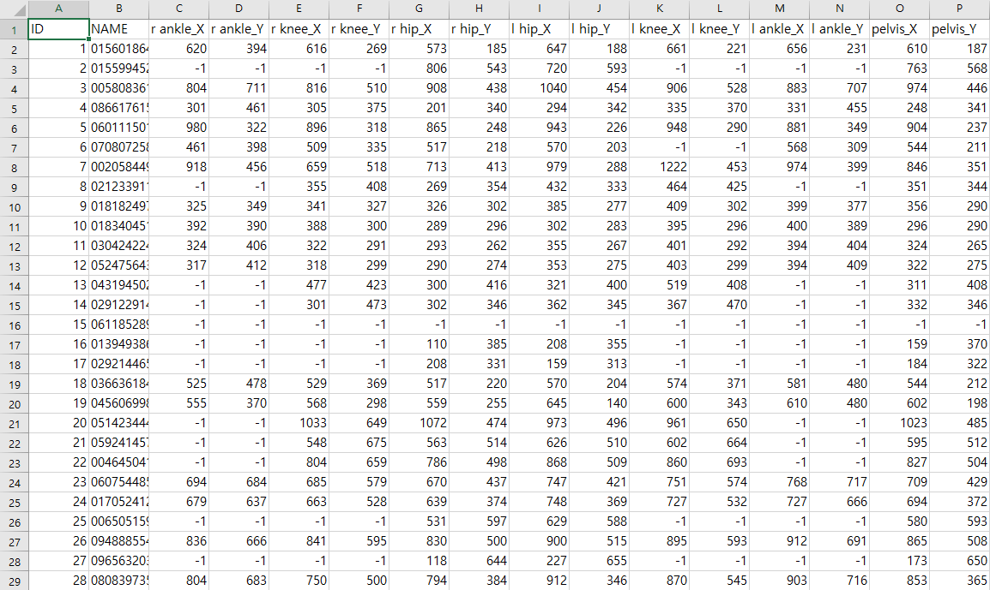
100%
Curation
MpII Human Pose Dataset in Kaggle
MPII Human Pose dataset is a state of the art benchmark for evaluation of articulated human pose estimation. The dataset includes around 25K images containing over 40K people with annotated body joints. The images were systematically collected using an established taxonomy of every day human activities. Overall the dataset covers 410 human activities and each image is provided with an activity label.
Dataset URL : https://www.kaggle.com/nicolehoelzl/mpii-human-pose-data

Slide 8
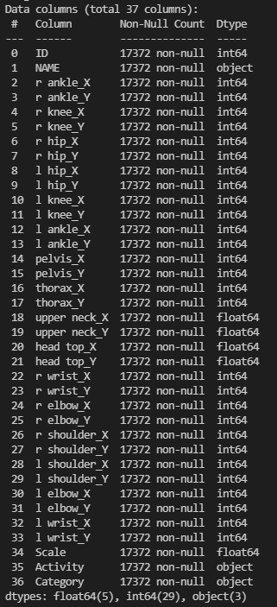
100%
Datasize
17372 rows X 37 attributes

Slide 9
100%
Inspection

Slide 10
100%
Inspection

Slide 11
02
Classification & Clustering

Slide 12
100%
Classification Algorithm
Clustering Algorithm
Decision tree
2. Logistic regression
3. SVM
Meanshift
K-Means
GMM
AgglomerativeClustering
Most influence the classification accuracy in Dataset
Col 2 ~ Col 33 in dataset A have a joint point. The pose has to be combined with each feature, so it is expected that it will inevitably affect all of the classifications.

Slide 13
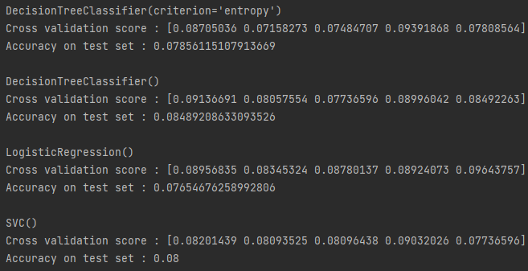
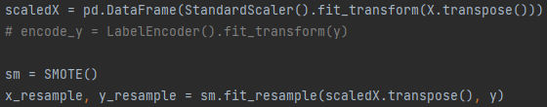
Preprocessing
Accuracy : 7~8%
First, we only scale and smooth. But As shown on the right, the accuracy was very low.
So we decide to “Reduce the category”.
Notes:
모든 카테고리 -> 현저히 낮은 정확도
그래서 개수를 줄이기로 결정

Slide 14
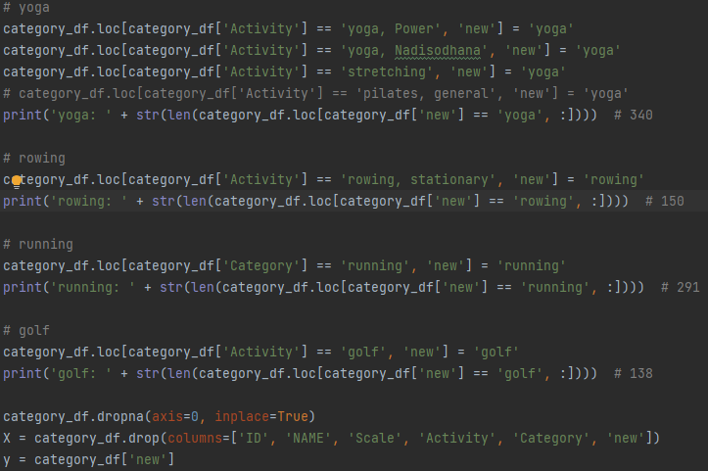
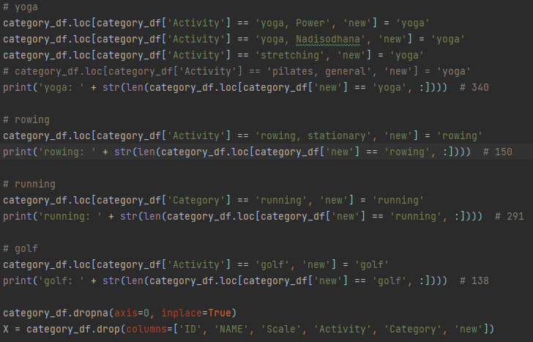
Preprocessing
We choose 4 categories in many activities.
yoga
rowing
running
golf
By this work, we can get the 70~80% accuracy.

Slide 15
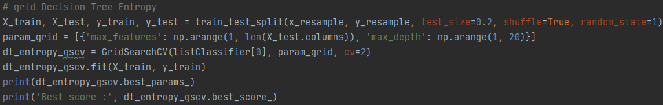
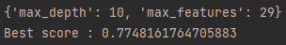
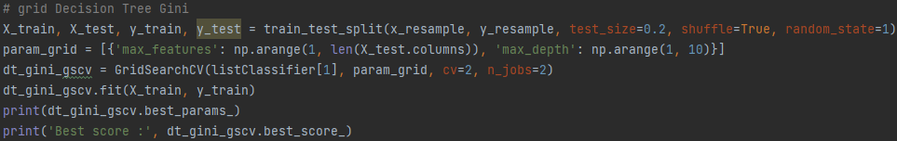
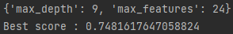
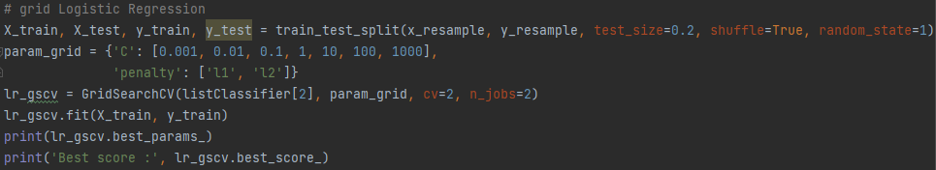
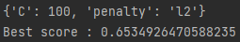
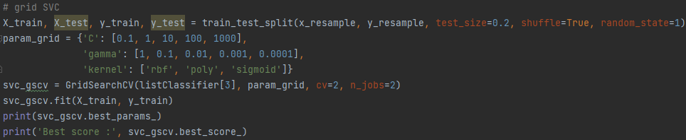
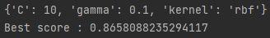
Notes:
grid search를 통해 best paramete와 score 출력

Slide 16
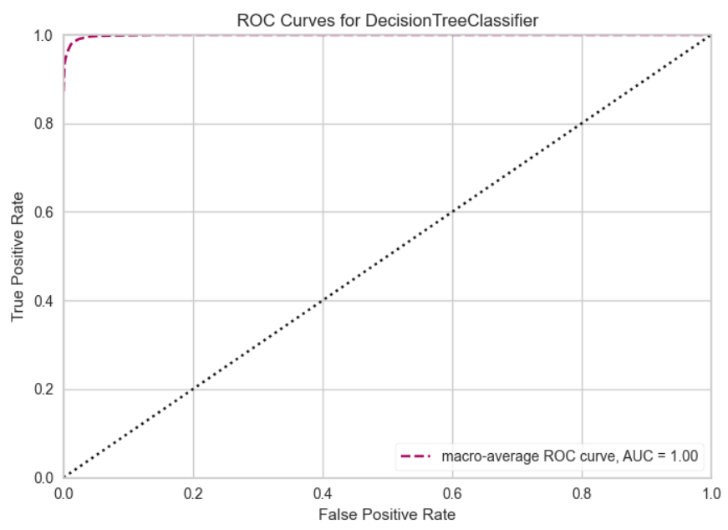
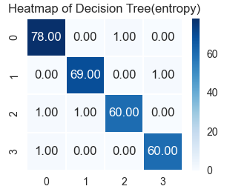
Decision Tree(entropy)
Notes:
Confusion matrix, ROC-CURVE를 사용하여 classficiation evaluation을 진행하였고 각 알고리즘의 precision,recall,f1-score 값을 구했습니다.

Slide 17

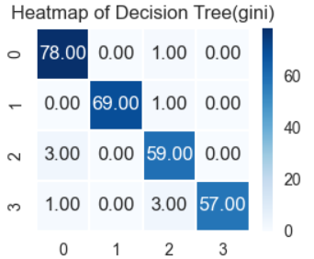
Decision Tree(gini)

Slide 18
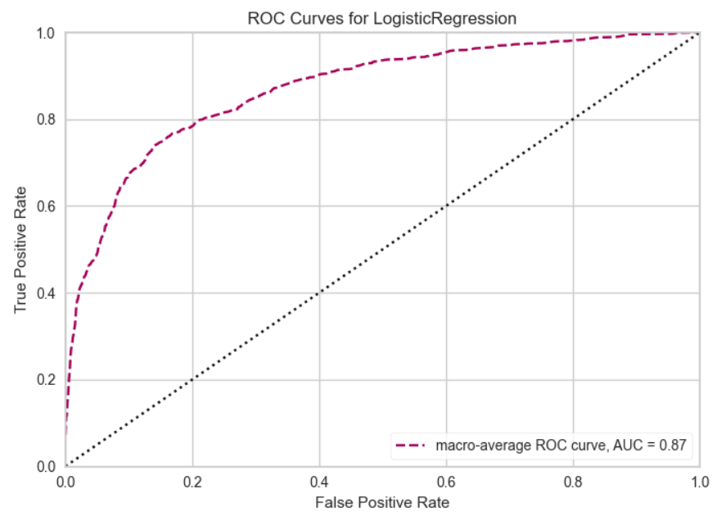
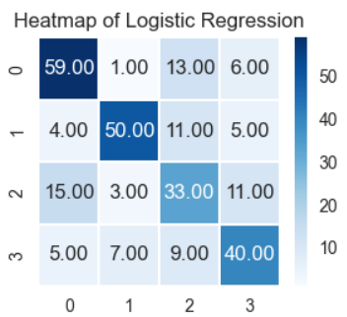
Logistic Regression

Slide 19
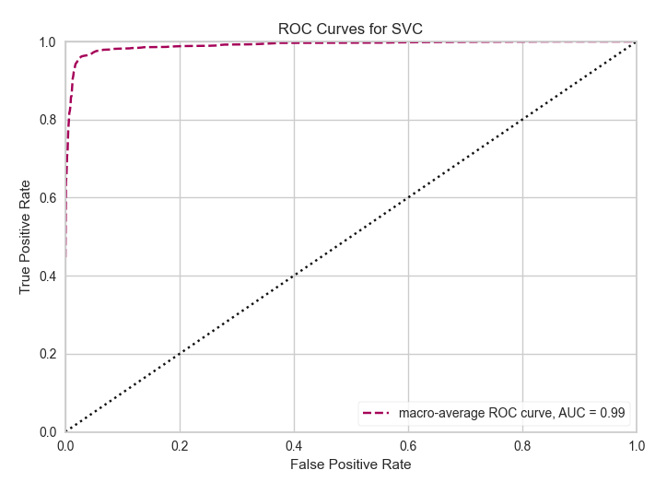
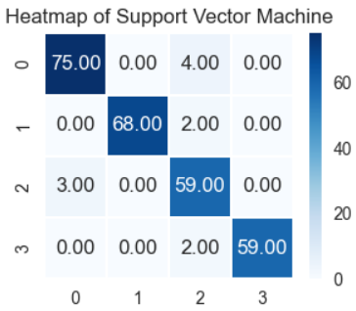
SVM

Slide 20
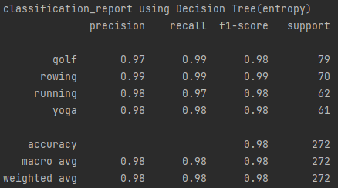
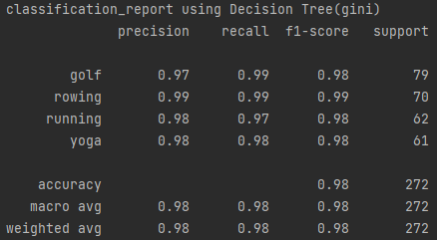
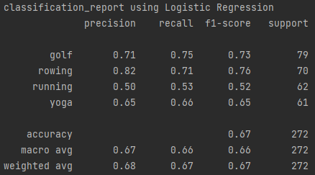
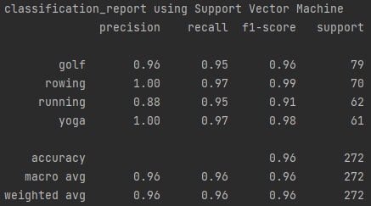
Confusion Matrix
Decision Tree(entropy)
Decision Tree(gini)
Logistic Regression
SVM

Slide 25
03
Wise Prophet & Member rules

Slide 26
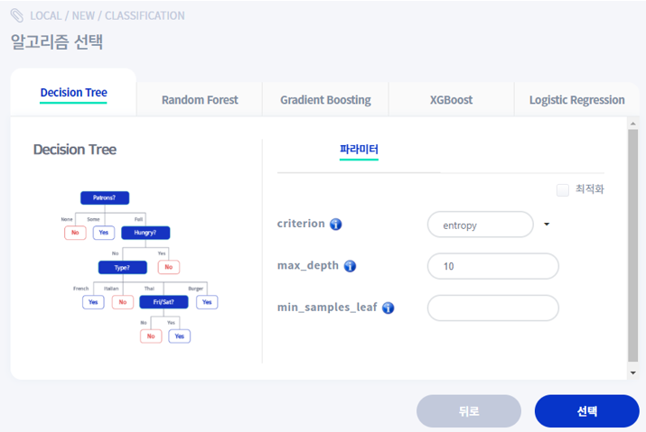
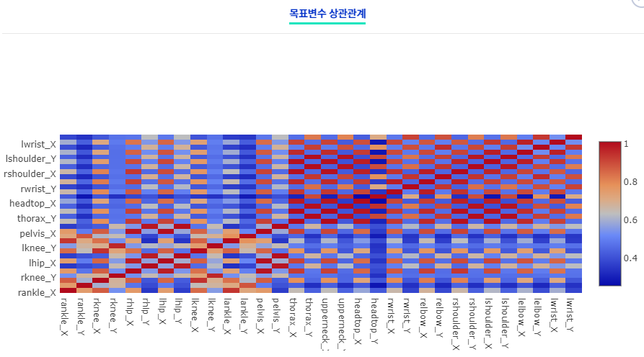
100%
Wise prophet
※ We conducted wise prophet with the “best parameters” derived from the previous results.

Slide 27
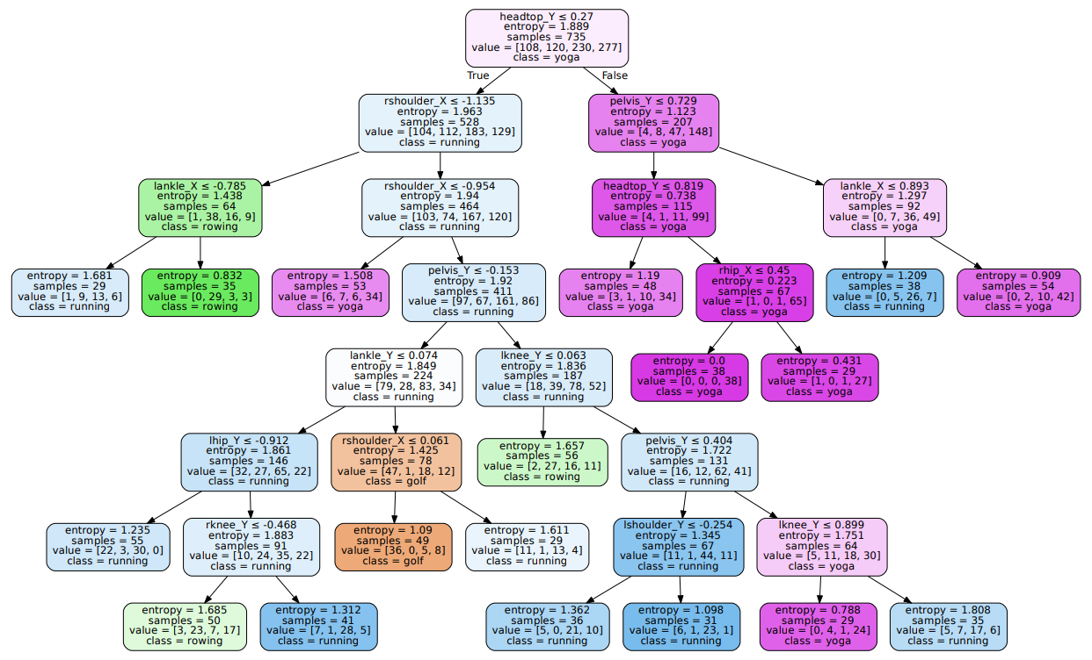
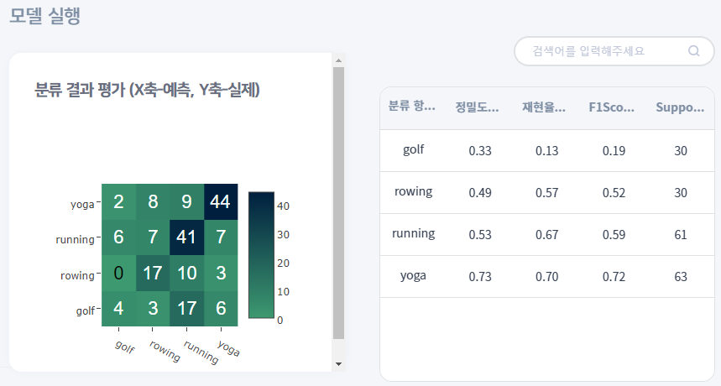
100%
Decision Tree(entropy)

Slide 28
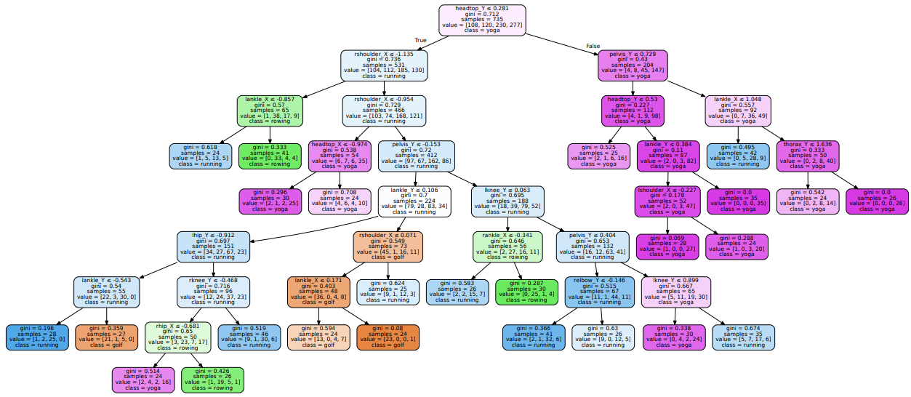
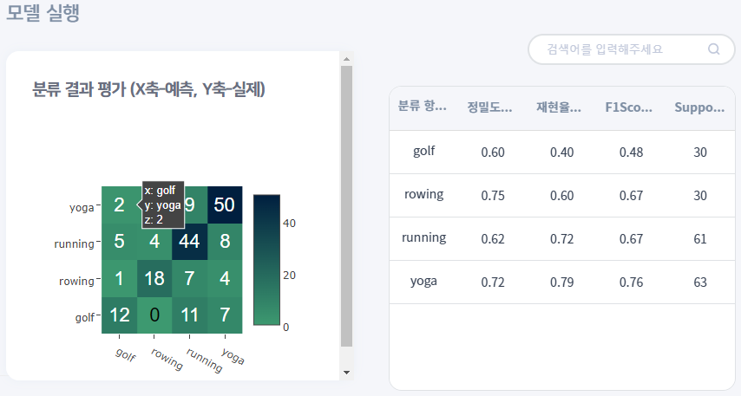
100%
Decision Tree(gini)

Slide 29
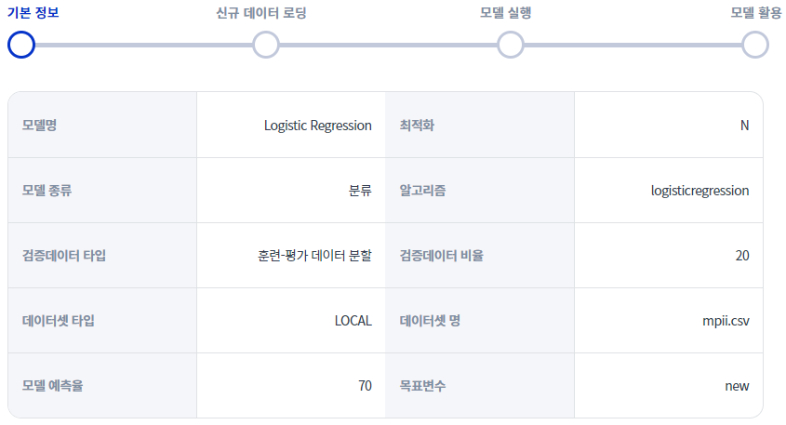
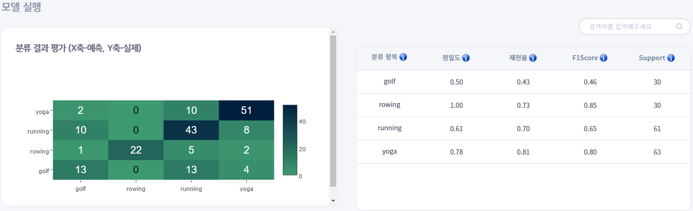
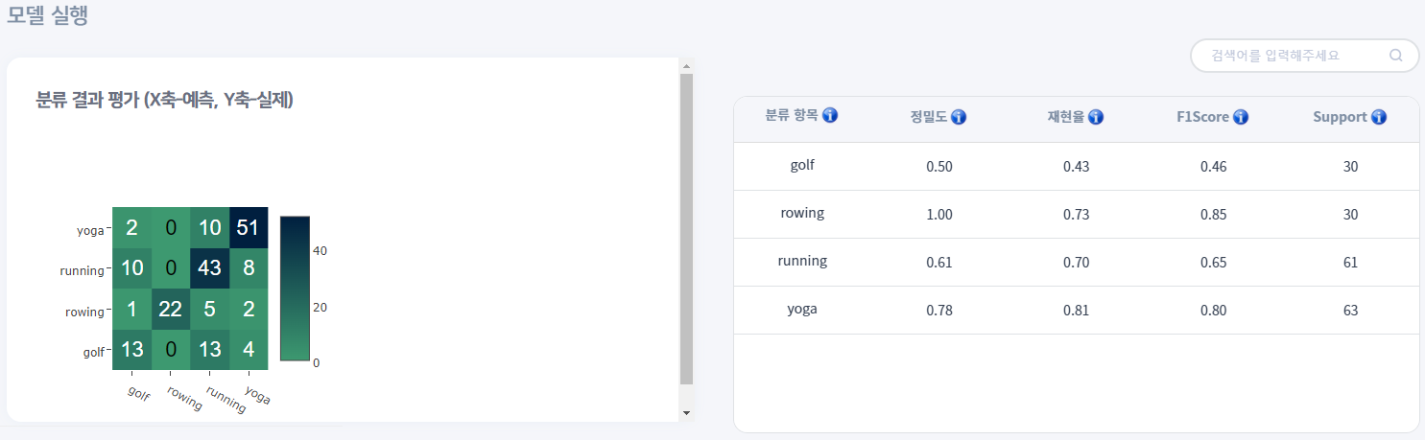
100%
Logistic Regression

Slide 30
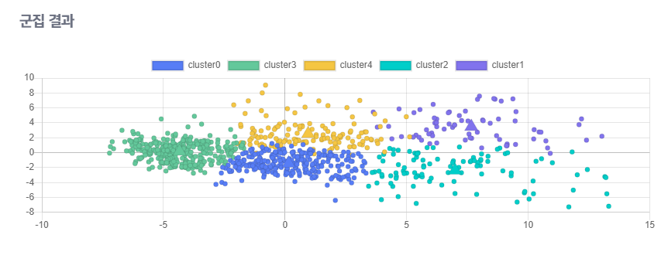
100%
K-Means

Slide 31
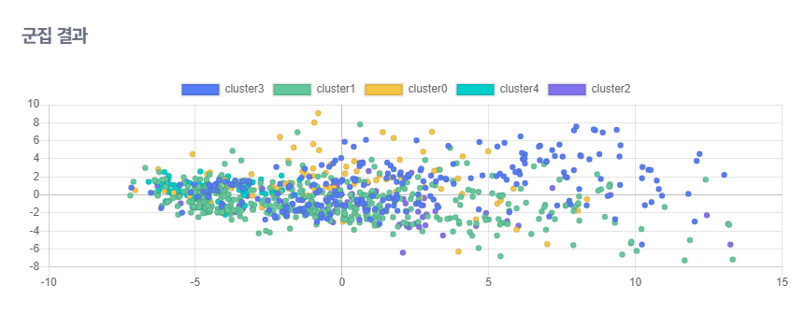
100%
GMM

Slide 32
100%
Project Schedule
MON | TUE | WED | THU | FRI | SAT | SUN
18 | 19 | 20 | 21 | 22 | 23 | 24
25 | 26 | 27 | 28 | 29 | 30 | 31
11.1 | 2 | 3 | 4 | 5 | 6 | 7
8 | 9 | 10 | 11 | 12 | 13 | 14
15 | 16
Proposal
Preprocessing
Meeting
Making
Classification / Clustering
Function
Meeting
Meeting
Finishing work & Prepare Final Presentation
Final

Slide 33

100%
정두화
Pre-processing
Classification-
Decision Tree,
Logistic
허서윤
Clustering – MeanShift
Data inspection
이정명
Classification-
SVM
Wise Prophet
최찬영
Clustering-
KMeans
GMM
Aggolmerative

Slide 34
100%
Thank you

